Slide 1
Innovative Surface Solutions
Website redesign

Slide 2
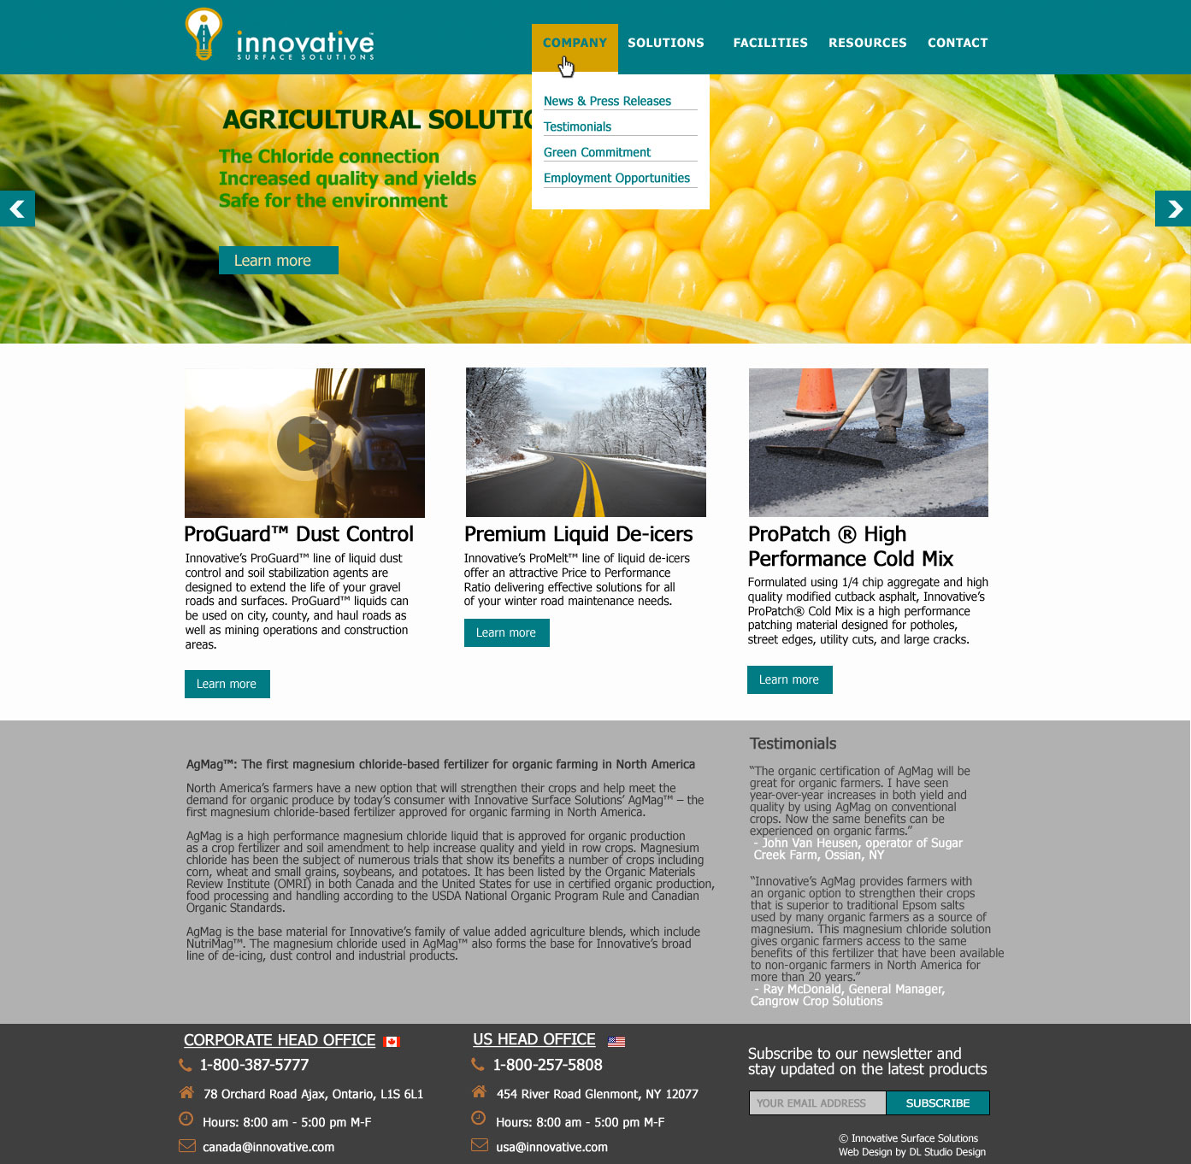
Home page with the hover menu

Slide 3
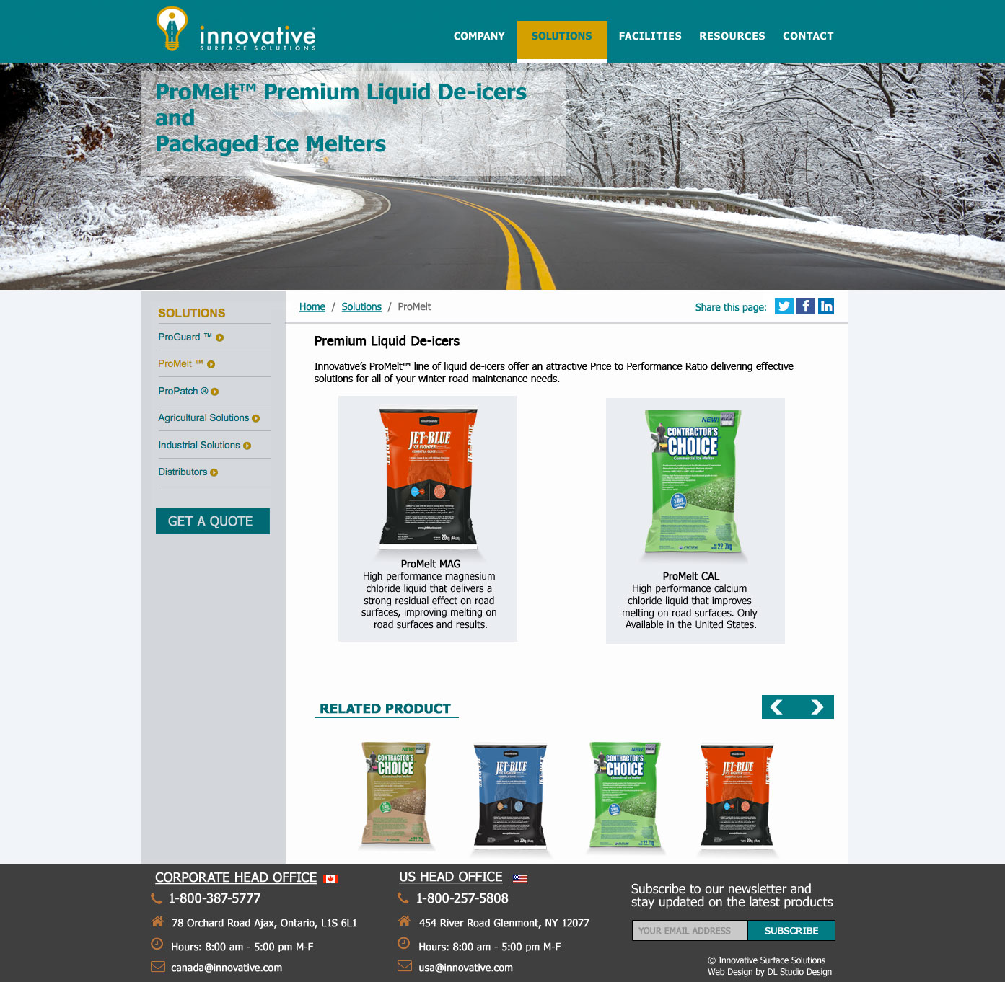
Secondary page layout

Slide 4
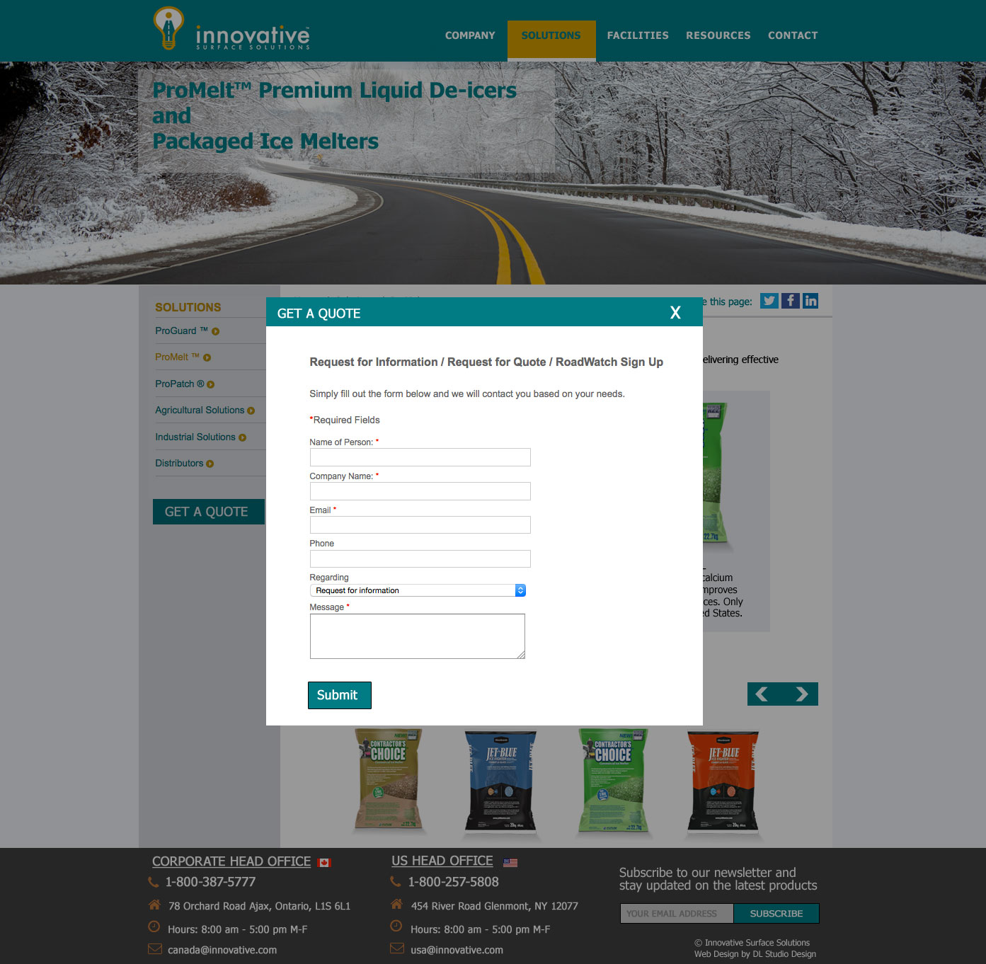
Get a quote

Slide 5

Mobile home page

Slide 6

Mobile home page with open menu

